Slide 1
Interreg V-A – Estonia Latvia 2014 – 2020 Project "Boosting cross border entrepreneurial activity in social and creative industries sector" (Social&Creative) Estonian social and creative entrepreneurs are looking for Latvian partners for co-operation ideas
This presentation reflects the views of the author. The managing authority of the programme is not liable for how this information may be used.

Slide 2
INTELLECTUAL PROPERTY WORKSHOPS
Idea:
A service that helps social entrepreneurs prevent problems with law and make them acknowledge the object of intellectual property not just as a tool but valuable outcome that could have several ways of usage or worth.
My research about acknowledging intellectual property among the Estonian social entrepreneurship that there is a problem that need solving.
Thoughts for co-operation:
I am lookinkg for a partner who would like to work together to develop this idea and then deal with it in Latvia.
Contact: Heidi Raudsepp <heidiraudsepp7@gmail.com>

Slide 3
MAPPING THE CULTURAL AND MUSICAL CLUSTERS OF LIVONIA
Idea:
Mapping and enhancing co-operation between the cultural and musical undertakings & pop music clusters of Livonia. Mapping and bringing together pop music clusters' representatives in Tartu, Riga & Latvia.
F.e.: in Tartu, we have: Production/industry: Degritter, Vinyl Plant; Recording companies: Frotee, Vaiguviiul, Gramophonetree Records; Studios, Club environments etc.
Partners: Psühhoteek (Tartu, EST), Mākslas telpa Mala (Cesis, LAT), Vinilbars (Riga, LAT).
Within the project, the Psühhodisko Festival in Tartu will take place on 22.-23.03.2019.
Contact: Ahto Külvet. Psühhoteek psuhhoteek@gmail.com
FB: https://www.facebook.com/psuhhoteek/
https://www.vinylhub.com/shop/26289-psuhhoteek

Slide 4
“REBRAND”
Idea: “Rebrand” – workshops for NEET joungsters, who need a new start.
NEET joungsters are young people (aged 15-24 years), who are neither in employment nor in education or training.
This project helps through coaching and different workshops (self-branding, time planning, self expression, etc) NEETs to find new motivation, build their self-esteam to go to work, start school again or go to training. It helps them to rebrand themselves from NEET's to successful members of the society.
Thoughts for co-operation: I am looking for a partner who would like to work together to develop this idea and then deal with it in Latvia.
Contact: MTÜ Magus Mõte. Jaana Hinno, jaanahinno@gmail.com

Slide 5
Entrepreneurship village as a franchise model
Idea: Developing the Entrepreneurship Village as a franchise model.
The more distant idea is to spread the Entrepreneurship Village model to Hong Kong. Opportunities are explored.
Co-operation thoughts: I had contact with two Latvian ladies, one of them works for SSE Riga and the other for Latvian Chamber of Commerce.
Collaborative ideas will be developed with potential partners. It is possible that we will develop a completely separate franchise model that could be tested with Latvian partners. Latvian partners needed.
Contacts: Mehis Pärn. mehis@ettevotluskyla.ee;
Ettevõtlusküla webpage: http://ettevotluskyla.ee/
FB: https://www.facebook.com/ettevotluskyla/

Slide 6
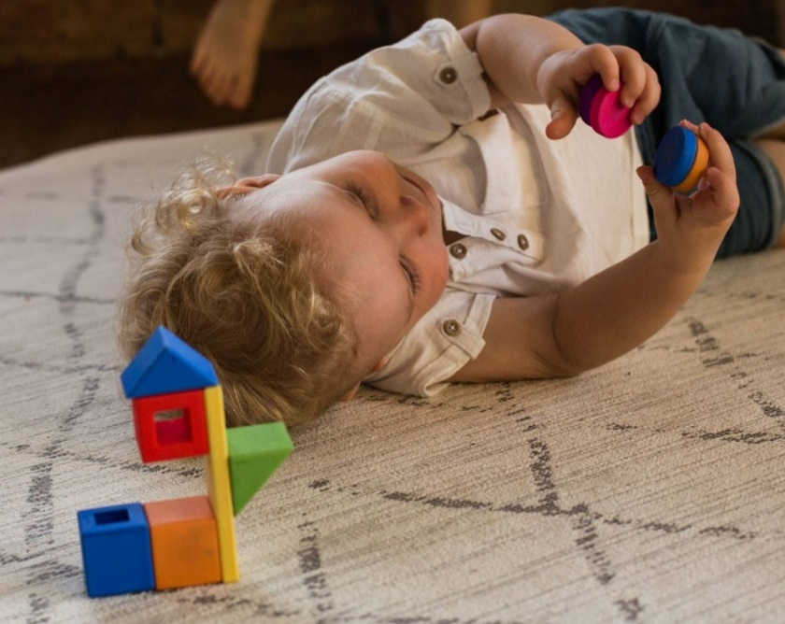
Tubly magnetic blocks for babies
Idea: It is planned to manufacture and market a series of magnetic blocks for children aged 2-6, Tubly. A block set consisting of traditional and special shapes blocks, in which all the sides are magnetically interconnected. This allows the blocks to be fixed to each other both vertically and horizontally.
Tubly blocks have a working prototype.
Toughts for co-operation: •
We have been planning to sell them for the first market through Amazon.com to the United States.
At the moment, the development of blocks is behind the initial investment required by the producer and the production. If there should be small-scale plastic manufacturing or toy production in Latvia, I would be interested in know-how.
Contact: Anu Aun anu.aun@gmail.com Klotsivabrik OÜ https://www.f6s.com/klotsivabriko

Slide 7
Collaborative idea/project should:
1) be between at least 2 partners (1 from Latvia, 1 from Estonia);
2) be innovative;
3) have a plan, how to be feasable?;
4) have a potential effect on the region.

